Slide 1


Synopsis Presentation on Medicure
Guided By: Presented By:
Prof. Ankita Agrawal Aditi Modi
Aditi Tiwari
Himanshu Patidar
Sejal Bhawsar

Slide 2
Contents
Introduction
1.1 Overview
1.2 Purpose
Literature Review
Problem Statement
Proposed Solution
Objectives
Theoretical Analysis
6.1 Block Diagram
6.2 Hardware Requirements
6.3 Software Requirements
Applications
REFERENCES

Slide 3
1. Introduction
1.1 Overview
The main goal of this chatbot is to assist users with medical queries, symptom analysis, and basic healthcare guidance. It will not replace doctors but can help provide initial suggestions like which nearby hospital you should visit, and guide them towards professional help when needed.
Key Features
Symptom Checker: Users can input symptoms, and the chatbot suggests possible conditions based on a medical datasets.
Medication Reminders: Sends notifications for taking medicines on time.
Emergency Support: Guides users to nearby hospitals or provides helpline numbers.
1.2 Purpose
Provide Instant Healthcare Assistance – The chatbot offers quick responses to medical queries, helping users with symptom analysis, health advice, and general medical guidance.
Enhance Accessibility & Awareness – It improves access to healthcare information, especially for people in remote areas, and educates users about diseases, medications, and preventive care.
Reduce Healthcare System Load – By handling common medical queries, the chatbot minimizes unnecessary hospital visits, allowing doctors to focus on critical cases.
Support Medication & Appointment Management – It helps users by sending medication reminders and assisting in booking doctor appointments, improving overall healthcare efficiency.

Slide 4
2. Literature Review
Summery of Solutions/Systems already available that are addressing the same issue/problem.
Sr. No. | Name of Solution/System | Features | Limitations/ Drawbacks
1 | Ada Health | AI-driven symptom checker, personalized health assessment, and medical advice | Limited diagnosis accuracy, requires subscription
2 | Babylon Health | Symptom checker, telemedicine. | Requires subscription, limited availability

Slide 5
3. Problem Statement
Access to timely and reliable healthcare remains a significant challenge, particularly in remote areas where medical facilities are limited. Many individuals struggle to assess their symptoms, leading to unnecessary hospital visits or delayed treatment. Additionally, patients often forget medications, and healthcare professionals face increased workloads due to minor, avoidable consultations. Existing medical chatbots lack accuracy, multilingual support, voice interaction, and direct hospital integration.
This project aims to develop an AI-powered Medical Chatbot that provides instant symptom analysis, health guidance, medication reminders, and appointment scheduling, improving accessibility and reducing the strain on healthcare system.

Slide 6
4. Proposed Solution
Our Medicure improves on existing solutions by offering accurate, multilingual, and hospital-integrated healthcare assistance.
Key Features & Improvements
Advanced Symptom Analysis – AI-powered diagnosis with better accuracy.
Voice Support – Accessible to a wider audience.
Medication Reminders & Health Tips – Helps users manage their health.
Emergency Assistance – Provides urgent medical support and hospital locations.

Slide 7
5. Objectives
Provide Instant Healthcare Assistance – Offer quick and reliable symptom analysis, health guidance, and medical information.
Enhance Accessibility & Engagement – Support voice-based interactions for a wider user reach.
Optimize Healthcare Services – Reduce unnecessary hospital visits and ease the workload on medical professionals.
Improve Health Management – Assist users with medication reminders, appointment scheduling, and emergency support.

Slide 8
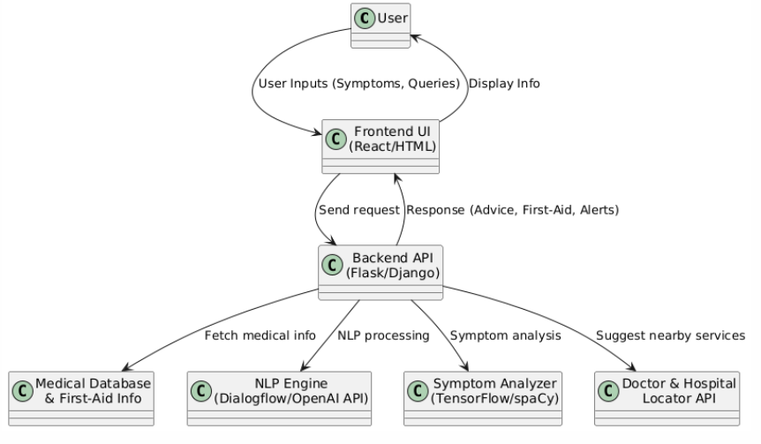
6. Theoretical Analysis
fig : Block diagram
(medicure)

Slide 9
6. Theoretical Analysis
6.2 Hardware Requirements
Processor: Intel Core i3 or higher (for local development) / Cloud-based server for deployment
RAM: Minimum 4GB (Recommended 8GB for smooth performance)
Storage: At least 10GB free space for databases, logs, and model storage
Internet Connection: Stable connection for API calls and cloud integration
6.3 Software Requirements
Programming Languages & Frameworks – Python (Flask/Django) or Node.js for backend development, and React.js, HTML, CSS, JavaScript for the frontend.
Database Management – MySQL, PostgreSQL, or Firebase for storing user data and medical records.
AI & NLP Tools – SpaCy, OpenAI API, for chatbot intelligence and natural language processing.
Cloud & Hosting – Google Cloud or AWS (optional) for cloud-based deployment and scalability.
Version Control – Git and GitHub for managing code and collaboration.

Slide 10
Applications
Symptom Analysis & Health Guidance – Helps users assess symptoms and provides initial medical advice based on AI-driven analysis.
Medication Reminders – Sends alerts for timely medication intake, improving adherence to prescribed treatments.
Emergency Assistance – Provides emergency helpline numbers, first-aid instructions, and nearby hospital locations.
Healthcare Awareness & Education – Offers information on diseases, preventive care, and lifestyle tips to promote better health management.

Slide 11
REFERENCES
1.Book
S. Kumar, R. Patel, “Medicare Chatbots: Revolutionizing Patient Assistance”, 2nd ed. New York: Healthcare Tech Press, 2024
2. Journal Article
A. Sharma, P. Verma, “Evaluating the effectiveness of AI-powered Medicare chatbots,” Journal of Medical Informatics, vol. 15, no. 2, pp. 78-90, June 2024.
3. Conference Papers
D. Mehta, L. Singh, “Enhancing healthcare accessibility through AI-driven Medicare chatbots,” in Proceedings of the International Conference on HealthTech Innovations, London, UK, 2024, pp. 150-155.
4. Website
J. Brown. (2024, Jan. 20). The role of AI chatbots in modern Medicare services [Online].
Available: [http://www.healthcareai.com/medicarechatbots](http://www.healthcareai.com/medicarechatbots)

Slide 12
GitHub Link
https://github.com/Adititiwari169
https://github.com/Himanshupatidar2005
https://github.com/Sejalbhawsar26
https://github.com/Aditimodi21

Slide 13
Thank You
Queries ?

